Slide 1
Geo 318 – Introduction to GIS Programming
Dr. Jim Graham

Slide 2
Notebooks
Got your notebook?
Please bring one with you and take notes!
Programming is like learning a foreign language – it is really hard to guess the words for things!
Writing notes has proven to help with remembering and you won’t have to ask the questions over and over

Slide 3
Introductions
What is your name?
What is your major?
What do you want to do for your career?

Slide 4
Why are you here?
You’re paying about $1500 for this class, $50 per lecture/lab
Why?

Slide 5
Why Program?
Automate tasks
Repeated over and over again
Speed up tasks
Computers can run 24/7
Allows for “exact” replication of processes
Except that the libraries you call will change!
“Encapsulate” functionality and expertise
You and everyone else can use it

Slide 6
To be successful
Be on time and attend every session you possibly can.
If you can't make a session, let me know why.
Start assignments when they are given and then finish them before they are due. This allows you to get help when needed.
Turn in all assignments BEFORE they are due.
Spend time programming!

Slide 7
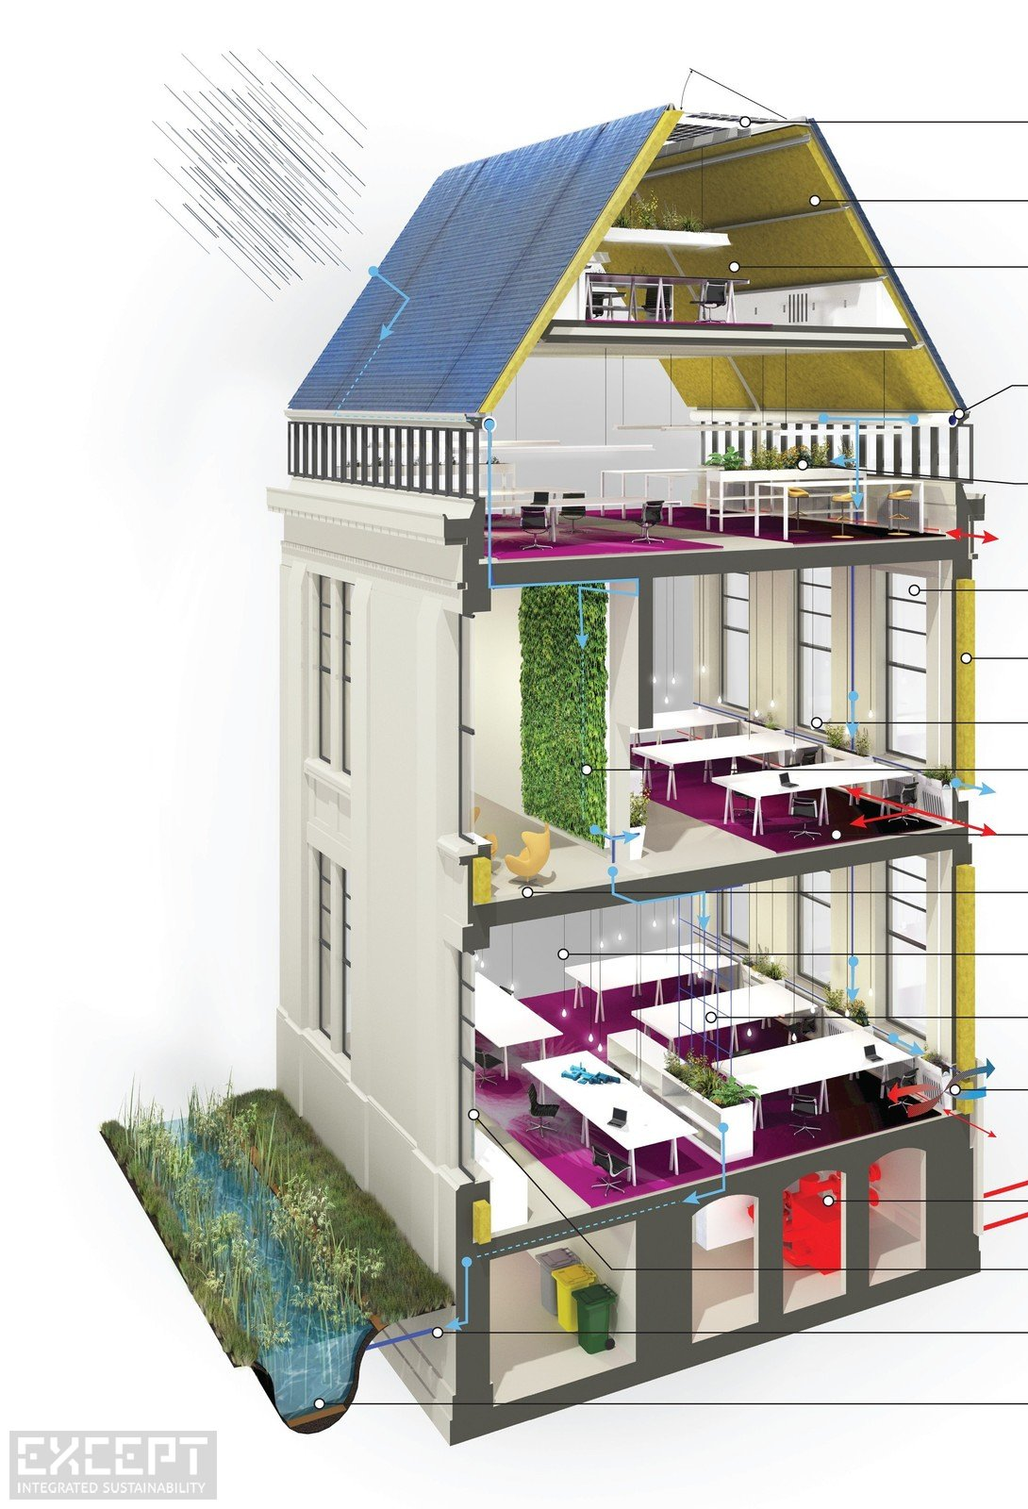
Programming Builds on Itself
Design
Classes
Modules
Testing
File access
Functions
Testing
Lists / Arrays
Loops
Conditional Statements
Mathematics
Data Types
Comments

Slide 8
Class Goals
Focus: Geospatial Programming
How computers work
How to program & debug code
How to tackle geospatial programming tasks
Python
By itself
With ArcGIS
With other software
Software development
Documentation
Management/Phases
Meeting users NEEDS

Slide 9
We are not learning…
Everything about Python
It’s a huge language that is growing all the time!
You only need a fraction of what is out there
The challenge is to find that fraction and get good at it!
Everything about programming ArcGIS
You will learn how to find anything available in programming ArcGIS
Everything about geospatial programming
More on this later…

Slide 10
We are learning…
Everything you need to figure out how to solve any programming problem in the geospatial discipline that can be solved!
Programming
Debugging
Finding answers
Getting help
Introduction to the larger world of software development

Slide 11
To be Successful
Types of learning:
Knowledge and concepts
Review the material on the website
Take notes and review them!
Skills
The only way to learn to ride a bike is to get on one
The only way to learn to program is to do it
4 hours outside of class per week at least!
Communication and Teamwork
Get to know your classmates

Slide 12
Learning Process
Read & practice material on web site
Quizzes encourage reading and let me know if topics are sinking in
Interactive lectures on critical and sticky areas
Take notes in your notebook
Start assignments early
“Play” until comfortable with the material
Turn in what you have! (including comments)
Repeat from 1

Slide 13
Structure
Canvas for assignments
Weekly homework -> Final project
Please turn in Python (“.py”) scripts
Website for weekly content
Email for Group Discussions
Canvas discussions? ListServe?
Teams of 1-2
There is no book but the web is full of great (and terrible) resources

Slide 14
Resources for Help
The Web – search for answers
ListServs – including Canvas blogs
Your team
Me and the tutors
ArcGIS help – best for Arc libraries
Others?
Anyone you can find who might have dealt with the same problem!

Slide 15
Grading
Assignments
Quizzes
Final Project

Slide 16
Keep Up with the Pack!
This class moves!
I’ll introduce a new topic and then you’ll have time to practice and work on the assignment
This is a skills class, not everything you need to know is online – you’ll need to attend classes
Turn in labs each week
Complete assignments outside of class and then turn in whatever you have when it is due
Get help when you need it!
If you get stuck for 20 minutes, get help!

Slide 17
Final Projects
Don’t worry about this unless you already know some programming and have a project you want to do.
If this is the case, make sure you have what you need to complete the project.
Otherwise, we’ll talk about projects ½ way through the semester.

Slide 18
Professionalism
Right now you are all like new employees
Note: I may be a reference for a future job
Show up on time and stay throughout class
Participate in discussions
Complete assignments on time
Help your class mates
Talking while someone else “has the floor”
See the “7 habits”

Slide 19
Repeating Problems
Practice programming (not just copy from other students or the web)
Start early (program some each day)
Not showing up or dropping out rather then getting help
How can we minimize these and other problems?
Please meet in groups of four and then have one person add your groups ideas to the board

Slide 20
To Be Successful
Attend class and lab
Start assignments when assigned and turn them in before they are due
Take notes
Practice the stuff that is hard
Get help!

Slide 21
Ready to become a NERD?
Learn a bunch of new terms (mostly TLAs)
Think like a computer
Amaze (and confuse) your friends!
Get a whole new wardrobe!

Slide 22
Definitions
Code – Instructions for a computer
Programming/Coding – writing, documenting, and testing code
Program – A file with instructions for a computer to execute to complete a task
Application – A program with a graphic user interface (as opposed to a command line interface)
Library – A file with code for a computer to be used by other programs

Slide 23
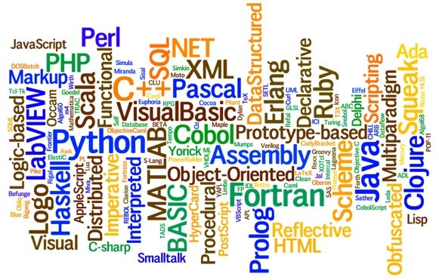
GIS Programming
https://geoawesomeness.com/learning-gis-programming-an-overview/

Slide 24
Why Python?
ESRI’s primary scripting language (for now)
Very popular in GIS (Arc and OpenSource)
Very flexible (can solve lots of problems)
Well supported (with Wing IDE)
Easy to learn (relative to complied languages)
Portable
But it is not the fastest language
Compiled (C/C++, Java, C#) are faster

Slide 25
Big Picture
ArcGIS Desktop
Wing IDE
Other Programs
Model Builder
(dead to me)
Python Scripts
ArcGIS Libraries
Other Libraries
Data
Data includes GIS (spatially referenced) and non-spatially reference

Slide 26
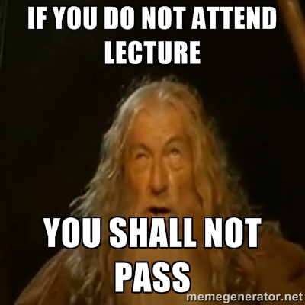
Previously, 10% did not pass!
If you fall behind in this class you will not pass!
Each week we learn concepts that are used the next week
We move together as a whole group
Attendance is mandatory
If you miss a class, make sure you catch up and get assignments in
Assignments must be in on time
If you fall behind you’ll be working on the wrong assignment

